Slide 1
Navigation
Neural Networks AS05
By: Nadav Porat ; 207825506

Slide 2
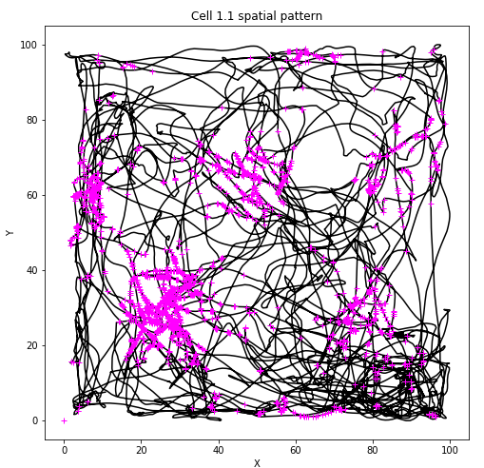
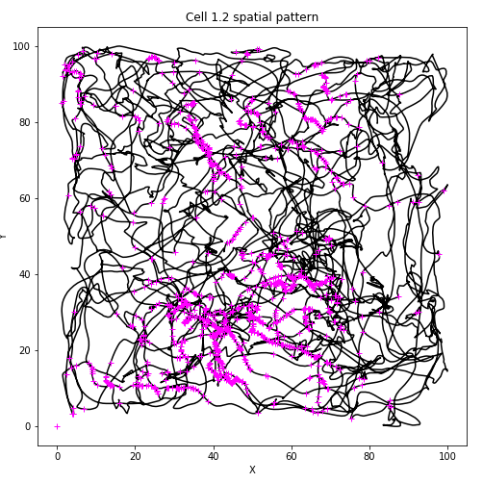
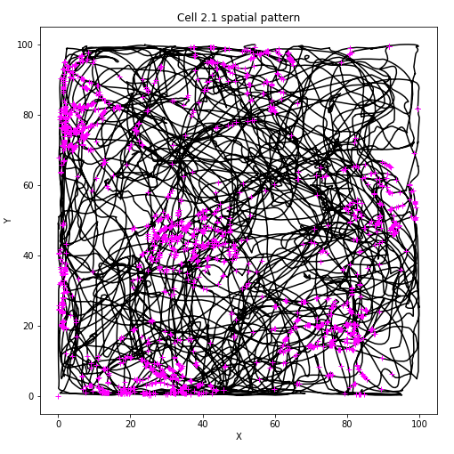
Cells spatial pattern

Slide 3
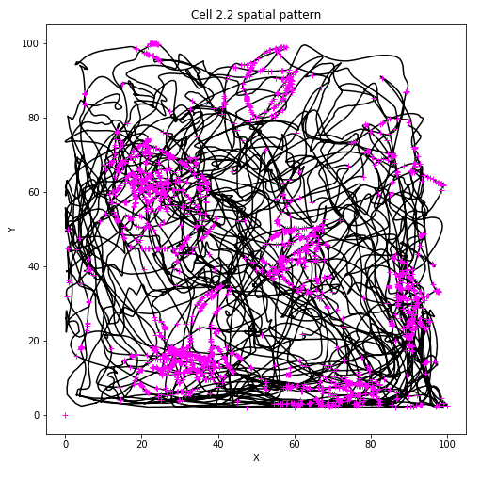

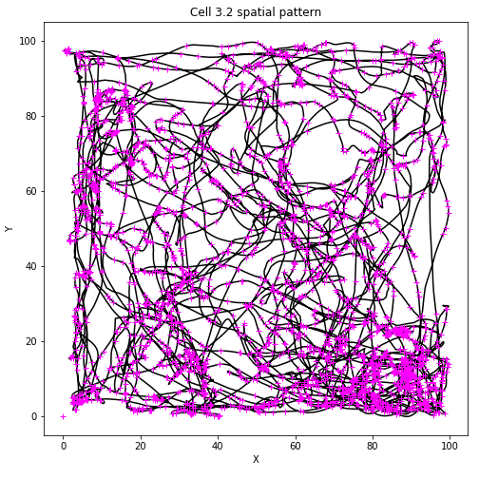
Cells spatial pattern

Slide 4
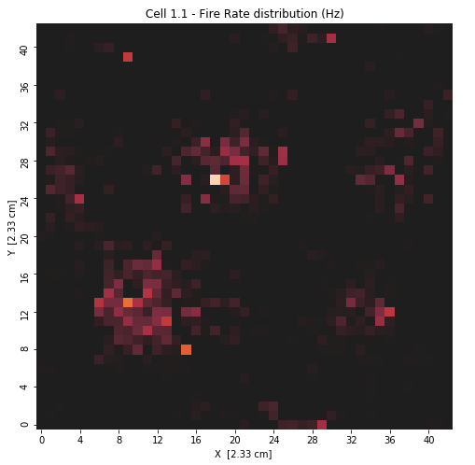
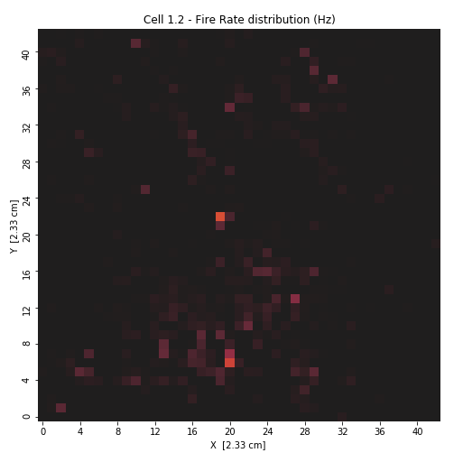
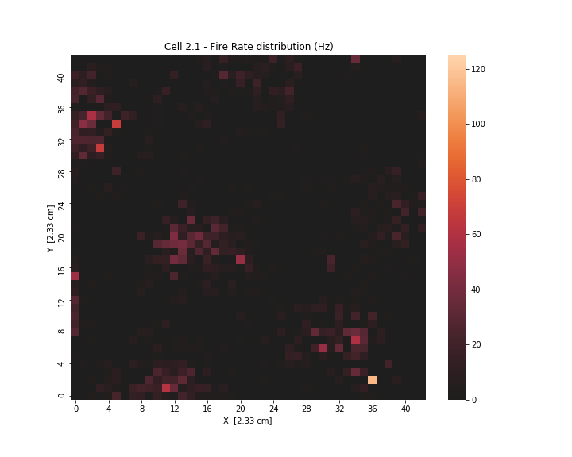

Fire-Rate heatmaps
I divided the data points into $43×43$ squares (because $\frac{599979}{43}=13953$), then counted the amount of spikes in each square and divided by the time the rat has been in said square.

Slide 5
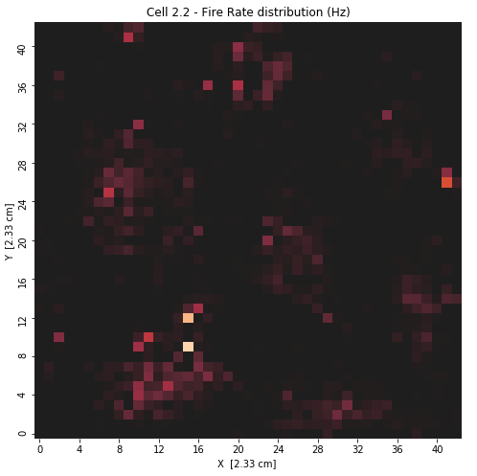
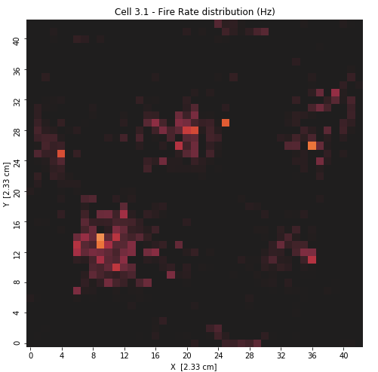
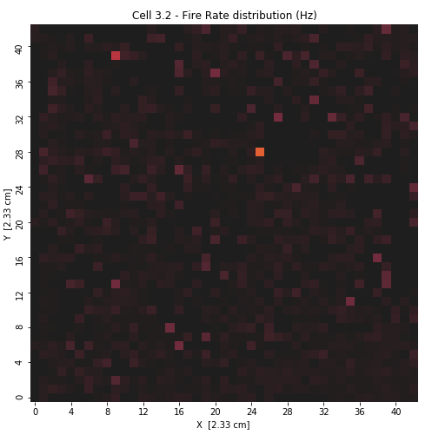
Fire-Rate heatmaps
I can certainly classify cells 1.1, 2.1, 2.2 and 3.1 as grid-cells. Cell 1.2 could be mistaken for a place-cell if not for the head direction analysis (coming up). Cell 3.2 has no coherent pattern.

Slide 6
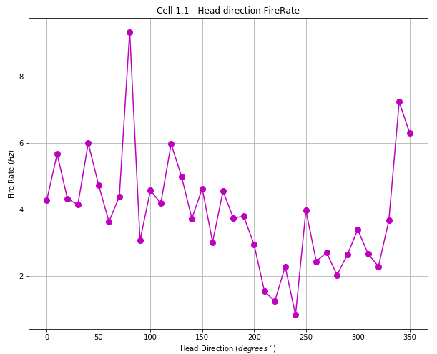
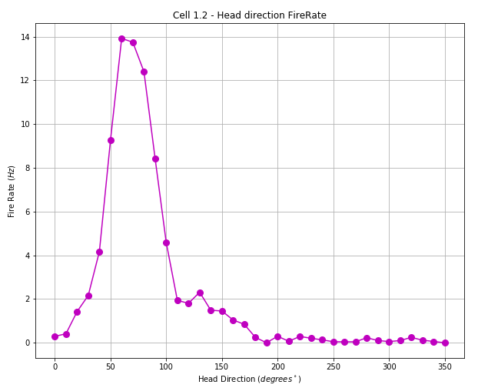
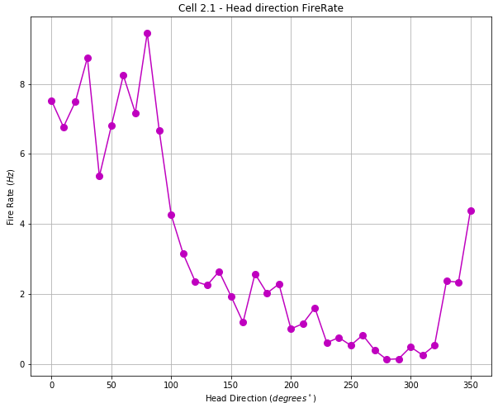

Head direction
I counted the amount of spikes in the span of $∆α=10°$ (from $0°$ to $360°$) and divided by the amount of time the rat looked in that direction.

Slide 7
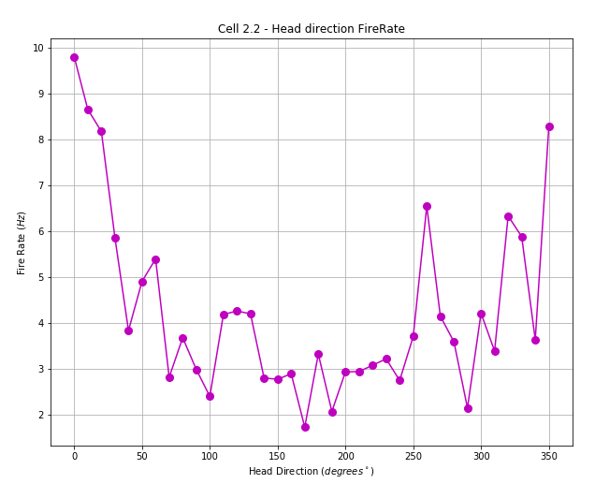
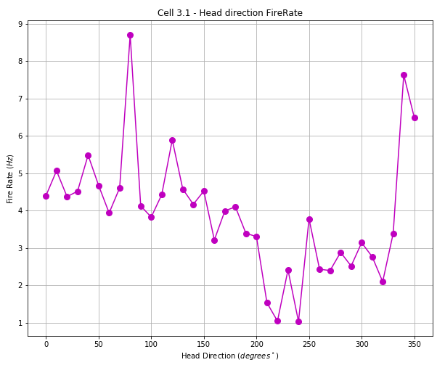
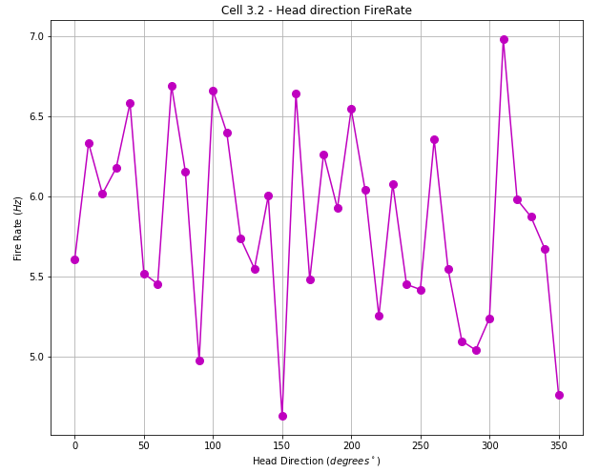
Head direction
We can clearly see that cell 1.2 is a head-direction cell. There are peaks in other cells as well, but they are not as conclusive. Cell 3.2 remains unclassified.

Slide 8
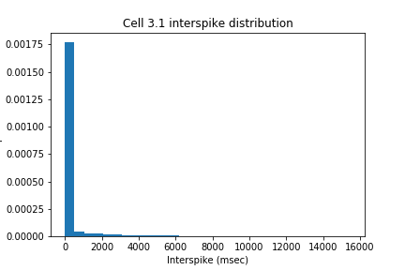


Statistical analysis
I will try to disprove the following null hypothesis: the spike patterns from the data $\left(μ^{′},σ^{′}\right)$ are taken from a uniform normal distribution $\left(μ, σ\right)$.
I wanted to model the normal distribution with the same $μ$ and $σ$ as the original interspike distribution. The problem is that a typical interspike distribution looks like this:
$$μ′≈266 \\ σ′≈1020$$

Slide 9
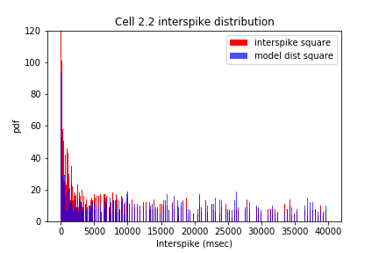


Statistical analysis – interspikes
The problems with mimicking this distribution is the large $σ$ (a very long “tail”) and the fact that there are no physical values (that’s why a regular normal distribution wouldn’t be good) .
After trial and error (mainly with “folded normal distribution”), I found that the best way to get the model distribution is by squaring the data and squaring a normal distribution.
$${\left(μ^{′}\right)}^{2}≈μ^{2} \\ {\left(σ^{′}\right)}^{2}≈σ^{2}$$
(squared)

Slide 10

Statistical analysis – interspikes
I went ahead and calculated the goodness of fit between the model and the data (squared) and found: $χ_{ν}^{2}≈1.54, p_{val}≈7×{10}^{−3}$ . So for cell 2.2, the null hypothesis is wrong, meaning that the interspike intervals did not generate from a normal distribution - $\left(μ^{′},σ^{′}\right)$.
$${\left(μ^{′}\right)}^{2}≈μ^{2} \\ {\left(σ^{′}\right)}^{2}≈σ^{2}$$

Slide 11
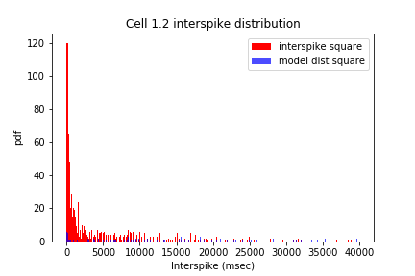
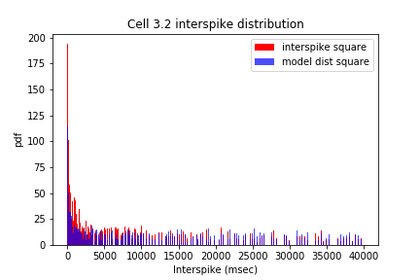
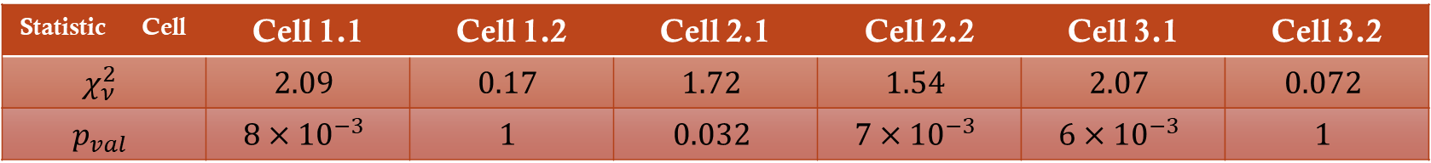
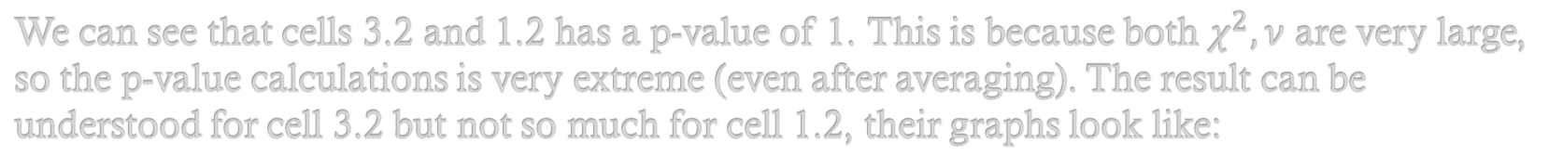
Statistical analysis – interspikes
After creating this interspike model for each cell, I tested the “goodness of fit” between the two distributions with $χ_{ν}^{2}, p_{value}$ statistics. The results (after averaging 500 iterations):
Statistic | Cell | Cell 1.1 | Cell 1.2 | Cell 2.1 | Cell 2.2 | Cell 3.1 | Cell 3.2
$$χ_{ν}^{2}$$ |  | $$2.09$$ | $$0.17$$ | $$1.72$$ | $$1.54$$ | $$2.07$$ | $$0.072$$
$$p_{val}$$ |  | $$8×{10}^{−3}$$ | $$1$$ | $$0.032$$ | $$7×{10}^{−3}$$ | $$6×{10}^{−3}$$ | $$1$$
We can see that cells 3.2 and 1.2 has a p-value of 1. This is because both $χ^{2}, ν$ are very large, so the p-value calculations is very extreme (even after averaging). The result can be understood for cell 3.2 but not so much for cell 1.2, their graphs look like:

Slide 12
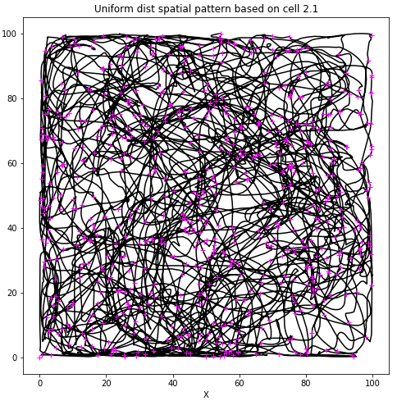
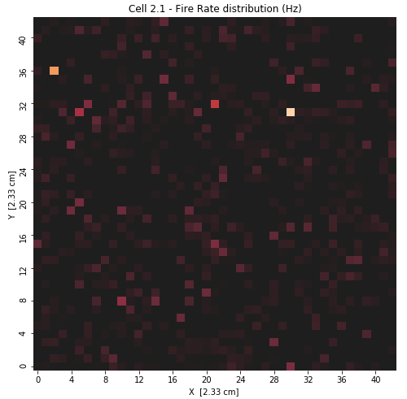

Statistical analysis – spikes spatial pattern
I focused on proving that the interspikes are not random and disregarded the spatial patterns. My reasoning is that the spatial pattern is based on the interspikes, so if one is not random, so is the other. In any case, I wanted to show the spatial pattern of the random distributions as well:
The new pattern, based on $(μ^{′},σ^{′})$ of cell 2.2 looks like this:

Slide 13
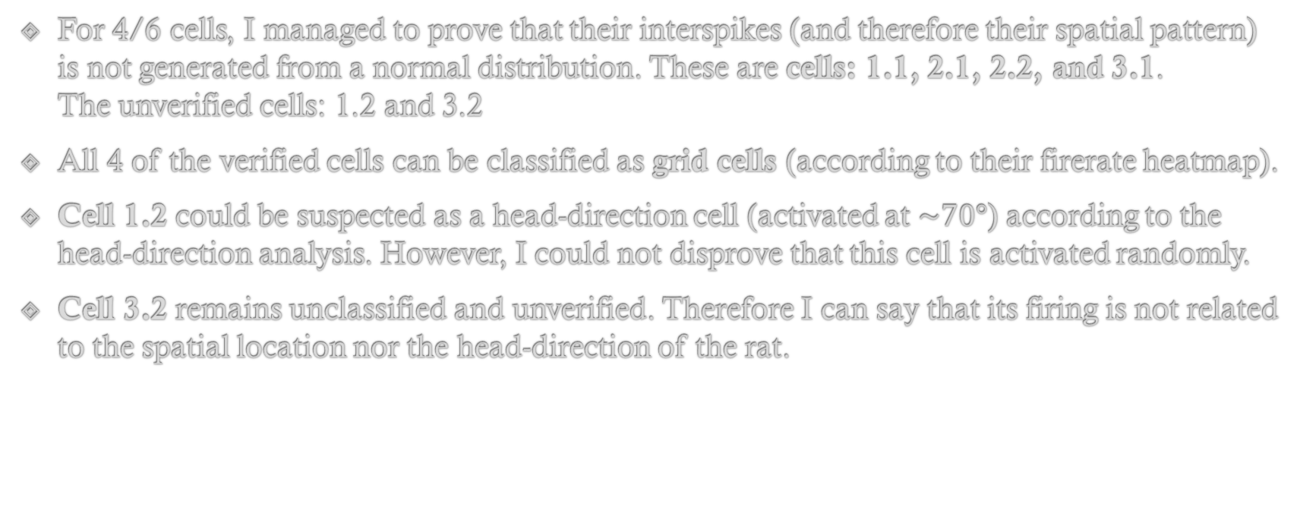
Summery
For 4/6 cells, I managed to prove that their interspikes (and therefore their spatial pattern) is not generated from a normal distribution. These are cells: 1.1, 2.1, 2.2, and 3.1. The unverified cells: 1.2 and 3.2
All 4 of the verified cells can be classified as grid cells (according to their firerate heatmap).
Cell 1.2 could be suspected as a head-direction cell (activated at $\sim 70°$) according to the head-direction analysis. However, I could not disprove that this cell is activated randomly.
Cell 3.2 remains unclassified and unverified. Therefore I can say that its firing is not related to the spatial location nor the head-direction of the rat.

